Slide 1
Chapter 1: Introduction to Project Management
Information Technology Project Management, Ninth Edition
Note: See the text itself for full citations

Slide 2
Learning Objectives (1 of 2)
Articulate the growing need for better project management, especially for information technology (IT) projects
Explain what a project is:
provide examples of IT projects
list various attributes of projects, and
describe constraints of project management
Define project management discuss key elements of the project management framework,
including project stakeholders,
project management knowledge areas,
common tools and techniques,
project success

Slide 3
Learning Objectives (2 of 2)
Discuss the relationship between:
project, program, and portfolio management and the contributions each makes to enterprise success
Summarize the role of project managers by describing what they do, what skills they need, the talent triangle, and career opportunities for IT project managers
Recall key aspects of the project management profession, including important components of its history, the role of professional organizations like the Project Management Institute (PMI), the importance of certification and ethics, and the advancement of project management software

Slide 4
Introduction (1 of 3)
Many people and organizations today have a new or renewed interest in project management
Worldwide IT spending was $3.5 trillion in 2017, a 2.4 percent increase from 2016 spending
The Project Management Institute reported that the number of jobs reached almost 66 million in 2017. By 2027, employers will need 87.7 million individuals working in project management–oriented roles

Slide 5
Introduction (2 of 3)
In 2017, the average annual salary (without bonuses) for someone in the project management profession was $112,000 in the U.S. and $130,866 in Switzerland
The top skills employers look for in new college graduates are all related to project management: team-work, problem-solving, and verbal communications
Organizations waste $97 million for every $1 billion spent on projects, according to PMI’s Pulse of the Profession® report

Slide 6
Introduction (3 of 3)
Advantages of Using Formal Project Management:
Better control of financial, physical, and human resources
Improved customer relations
Shorter development times
Lower costs and improved productivity
Higher quality and increased reliability
Higher profit margins
Better internal coordination
Positive impact on meeting strategic goals
Higher worker morale

Slide 7
What Went Wrong?
IT Projects have a terrible track record, as described in the What Went Wrong?
A 1995 Standish Group study (CHAOS) found that only 16.2% of IT projects were successful in meeting scope, time, and cost goals; over 31% of IT projects were canceled before completion
A PricewaterhouseCoopers study found that over half of all projects fail and only 2.5% of corporations consistently meet their targets for scope, time, and cost goals for all types of project

Slide 8
What Is a Project?
A project is “a temporary endeavor undertaken to create a unique product, service, or result”
Operations is work done to sustain the business
Projects end when their objectives have been reached or the project has been terminated

Slide 9
Examples of IT Projects (1 of 2)
A team of students creates a smartphone application and sells it online
A company develops a driverless car
A government group develops a system to track child immunizations
A global bank acquires other financial institutions and needs to consolidate systems and procedures

Slide 10
Examples of IT Projects (2 of 2)
Top Strategic Technologies for 2018 (Gartner)
Artificial Intelligence (AI) Foundation
Intelligent Things
Cloud to the Edge
Immersive Experience

Slide 11
Media Snapshot
Gartner predicted that by 2014, there would be more than 70 billion mobile application downloads every year, but it was almost double
Facebook is by far the most downloaded app, and the most popular category of all apps continues to be games (2.89 billions in 2021)
As of March 2017, Android users could download 2.8 million different apps, and Apple users could download 2.2 million
(Android 2.5 billion in 2021)

Slide 12
3. Learning Objectives (1 of 2)
Articulate the growing need for better project management, especially for information technology (IT) projects
Explain what a project is:
provide examples of IT projects
list various attributes of projects, and
describe constraints of project management
Define project management discuss key elements of the project management framework,
including project stakeholders,
the project management knowledge areas,
common tools and techniques,
and project success

Slide 13
2. Project Attributes
A project
has a unique purpose
is temporary
drives change and enable value creation
is developed using progressive elaboration
requires resources, often from various areas
should have a primary customer or sponsor
The project sponsor usually provides the direction and funding for the project
involves uncertainty
Project managers work with project sponsors, team, and other people involved in a project to achieve project goals

Slide 14
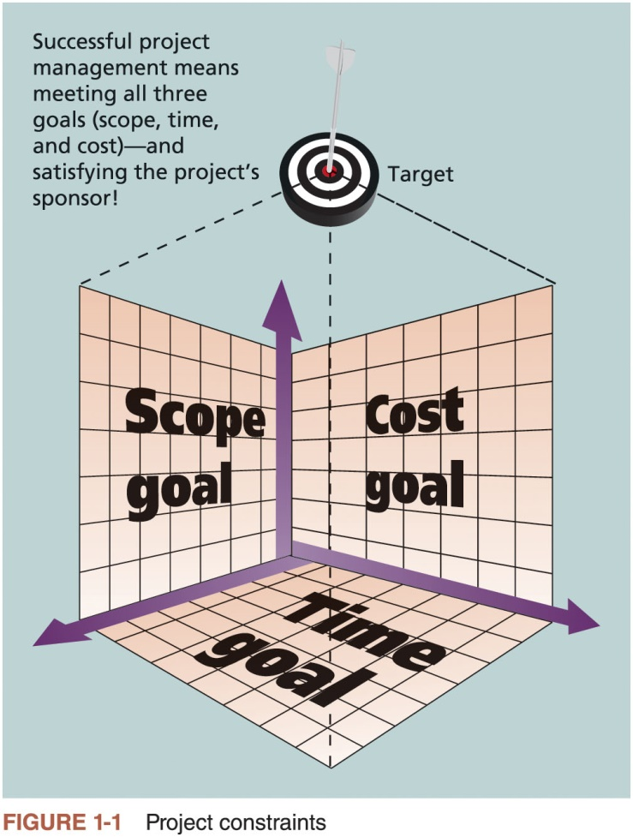
3. Project Constraints

Slide 15
Learning Objectives (1 of 2)
Articulate the growing need for better project management, especially for information technology (IT) projects
Explain what a project is:
provide examples of IT projects
list various attributes of projects, and
describe constraints of project management
Define project management discuss key elements of the project management framework,
project stakeholders,
project management knowledge areas,
common tools and techniques,
project success

Slide 16
What is Project Management? (1 of 2)
Project management is “the application of knowledge, skills, tools and techniques to project activities to meet project requirements”
Project managers strive to meet the triple constraint (project scope, time, and cost goals) and also facilitate the entire process to meet the needs and expectations of project stakeholders

Slide 17
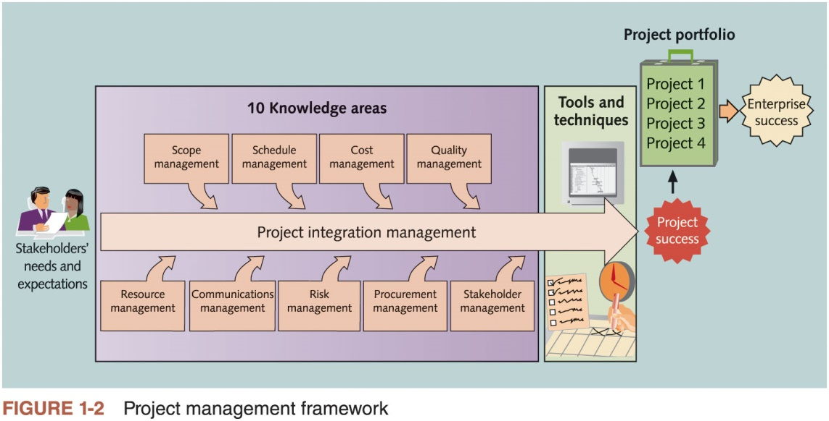
What is Project Management? (2 of 2)

Slide 18
1. Project Stakeholders
Stakeholders are the people involved in or affected by project activities
Stakeholders include
the project sponsor
banks and other financial institutions
the project manager
the project team
support staff
suppliers
opponents to the project

Slide 19
2. Project Management Knowledge Areas
Knowledge areas describe the key competencies that project managers must develop
Project managers must have knowledge and skills in all 10 knowledge areas (scope, schedule, cost, quality, resource, communications, risk, procurement, stakeholder, and project integration management)
This text includes an entire chapter on each knowledge area

Slide 20
3. Project Management Tools and Techniques (1 of 2)
Project management tools and techniques assist project managers and their teams in various aspects of project management
Some specific ones include
Project charter, scope statement, and WBS (scope)
Gantt charts, network diagrams, critical path analysis, critical chain scheduling (time)
Cost estimates and earned value management (cost)
See Table 1-1 for many more

Slide 21
3. Project Management Tools and Techniques (2 of 2)
PMBOK® Guide: lists tools and techniques based on their purpose:
Data gathering
Data analysis
Data representation
Decision making
Communication
Interpersonal and team skills

Slide 22
What Went Right?
The Standish Group’s CHAOS studies show improvements in the statistics for IT projects:
The number of successful projects was 29% in 2015
62% of small projects were successful, 6% of large, 9% of medium, and 21% of moderate size
39% of all agile projects were successful compared to 11% of waterfall projects

Slide 23
4. Project Success (1 of 4)
There are several ways to define project success:
The project met scope, time, and cost goals
The project satisfied the customer/sponsor
The results of the project met its main objective, such as making or saving a certain amount of money, providing a good return on investment, or simply making the sponsors happy

Slide 24
4. Project Success (2 of 4)
Factors of Success | Points
Executive sponsorship | 15
Emotional maturity | 15
User involvement | 15
Optimization | 15
Skilled resources | 10
Agile processes | 7
Modest execution | 6
Project management expertise | 5
Clear business objectives | 4
Source: The Standish Group, CHAOS Manifesto 2015 (2015)
Table 1-2 What Helps Projects Succeed?

Slide 25
4. Project Success (3 of 4)
Top three reasons why federal technology projects succeed
Adequate funding
Staff expertise
Engagement from all stakeholders

Slide 26
4. Project Success (4 of 4)
Research findings show that companies that excel in project delivery capability:
Use an integrated toolbox
Grow project leaders
Develop a streamlined project delivery process
Measure project health using metrics, like customer satisfaction or return on investment

Slide 27
Program and Project Portfolio Management
About one-quarter of the world’s gross domestic product is spent on projects
Two important concepts that help projects meet enterprise goals:
Use of programs
Project portfolio management

Slide 28
Programs
A program is “a group of related projects managed in a coordinated manner to obtain benefits and control not available from managing them individually” (PMBOK® Guide)
Examples of common programs in the IT field include infrastructure, applications development, and user support
A program manager provides leadership and direction for the project managers heading the projects within the program

Slide 29
Project Portfolio Management (1 of 2)
Project portfolio management (PPM) refers to a process used by project managers and project management organizations (PMOs) to analyze the potential return on undertaking a project
Project and program management are about execution and delivery---doing projects right.
PPM focuses on doing the right projects at the right time by selecting and managing projects as a portfolio of investments. It requires completely different techniques and perspectives.
As part of project portfolio management, organizations group and manage projects and programs as a portfolio of investments that contribute to the entire enterprise’s success
Portfolio managers help their organizations make wise investment decisions by helping to select and analyze projects from a strategic perspective

Slide 30
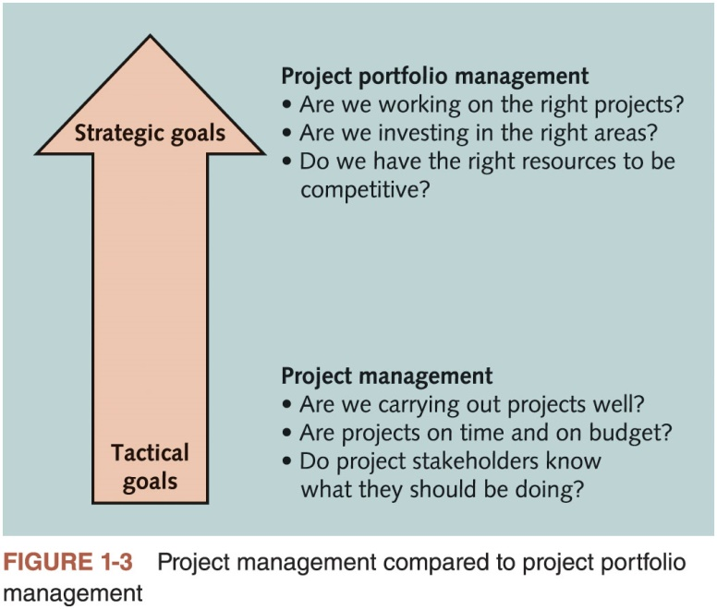
Project Portfolio Management (2 of 2)

Slide 31
Best Practice
A best practice is “an optimal way recognized by industry to achieve a stated goal or objective”*
Robert Butrick suggests that organizations need to follow basic principles of project management, including these two mentioned earlier in this chapter:
Make sure your projects are driven by your strategy.
Be able to demonstrate how each project you undertake fits your business strategy, and screen out unwanted projects as soon as possible
Engage your stakeholders. Ignoring stakeholders often leads to project failure. Be sure to engage stakeholders at all stages of a project, and encourage teamwork and commitment at all times
*Project Management Institute, Organizational Project Management Maturity Model (OPM3) Knowledge Foundation (2003), p. 13.

Slide 32
Organizational Project Management (1 of 2)
Organizational project management
Framework in which portfolio, program, and project management are integrated with organizational enablers in order to achieve strategic objectives

Slide 33
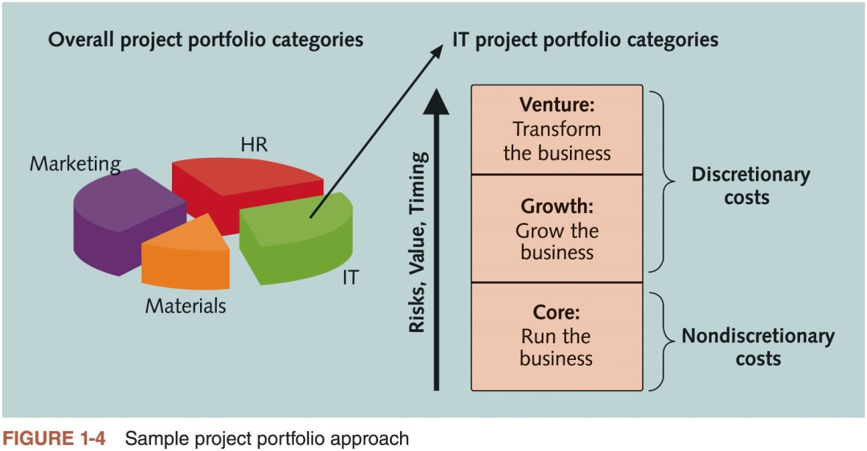
Organizational Project Management (2 of 2)
Notes:
Image shows that the costs of Core IT projects are nondiscretionary, which means that the company has no choice in whether to fund them.

Slide 34
The Role of the Project Manager
Project managers must work closely with the other stakeholders on a project, especially the sponsor and project team
They are also more effective if they are familiar with the 10 project management knowledge areas
And the various tools and techniques related to project management

Slide 35
Project Manager Job Description
Job descriptions vary, but most include responsibilities like planning, scheduling, coordinating, and working with people to achieve project goals
Project management is a skill needed in every major IT field, from database administrator to network specialist to technical writer

Slide 36
Advice for Young Professionals
A few questions to ask yourself to know if you would be a good project manager
Do you get frustrated by bad bosses? Do you think you could do a better job?
Are you interested in understanding the big picture of how organizations work and how your individual work or your project fits in?
Have you had other leadership roles, such as being a team captain, president of a club, or entrepreneur of a small business? Did you enjoy it? Did others think you did a good job?
Are you good at mentoring others? Do people ask you for help in developing their skills or your advice on what to do?

Slide 37
Suggested Skills for Project Managers (1 of 2)
The Project Management Body of Knowledge
Application area knowledge, standards, and regulations
Project environment knowledge
General management knowledge and skills
Soft skills or human relations skills

Slide 38
Suggested Skills for Project Managers (2 of 2)
Six traits of highly effective project managers as follows:
Be a strategic business partner
Encourage and recognize valuable contributions
Respect and motivate stakeholders
Be fully vested in success
Stress integrity and accountability
Work in the gray/Be able to deal with ambiguity

Slide 39
PMI Talent Triangle® and the Importance of Leadership Skills*
The talent triangle includes:
Technical project management skills
Strategic and business management skills
Leadership skills
Leadership styles include:
Laissez-faire
Transactional
Servant leader
Transformational
Charismatic
Interactional

Slide 40
Careers for IT Project Managers (1 of 2)
In a 2017 survey, IT executives listed the “ten hot tech skills” they planned to hire for in 2017
Project management was second only to full-stack software development
Even if you choose to stay in a technical role, you still need project management knowledge and skills to help your team and organization

Slide 41
Careers for IT Project Managers (2 of 2)
1. | Full-stack software development
2. | Project management
3. | Cyber-security
4. | Networking
5. | User experience/user interface (UX/UI) design
6. | Quality assurance (QA)/testing
7. | Cloud engineering
8. | Big data
9. | Machine learning/artificial intelligence
10. | DevOps
Source: Sharon Florentine, “10 IT skills that employers need in 2017,” CIO from IDG (February 1, 2017).
Table 1-4 Ten hot tech skills for 2017

Slide 42
The Project Management Profession
The profession of project management is growing at a very rapid pace
It is helpful to understand the history of the field, the role of professional societies like the Project Management Institute, and the growth in project management software

Slide 43
History of Project Management (1 of 4)
Some people argue that building the Egyptian pyramids was a project, as was building the Great Wall of China
Most people consider the Manhattan Project to be the first project to use “modern” project management
This three-year, $2 billion (in 1946 dollars) project had a separate project manager and a technical manager

Slide 44
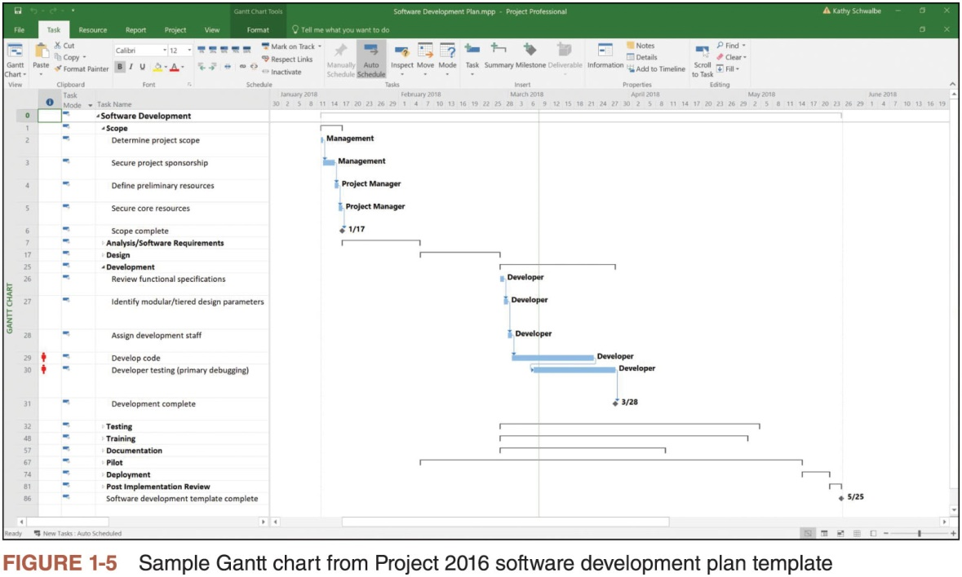
History of Project Management (2 of 4)

Slide 45
History of Project Management (3 of 4)
In the 1990s, many companies began creating PMOs to help them handle the increasing number and complexity of projects
A Project Management Office (PMO) is an organizational group responsible for coordinating the project management function throughout an organization

Slide 46
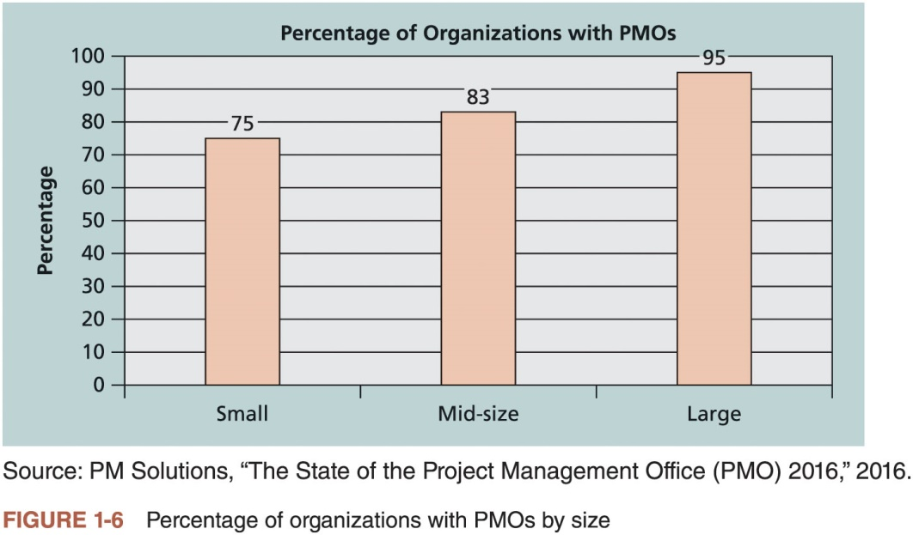
History of Project Management (4 of 4)

Slide 47
Global Issues
Several global dynamics are forcing organizations to rethink their practices:
Talent development for project and program managers is a top concern
Basic project management techniques are core competencies
Organizations want to use more agile approaches to project management
Benefits realization of projects is a key metric

Slide 48
The Project Management Institute
The Project Management Institute (PMI) is an international professional society for project managers founded in 1969
PMI has continued to attract and retain members, reporting more than 500,000 members worldwide by late 2017
There are communities of practices in many areas, like information systems, financial services, and health care
Project management research and certification programs continue to grow

Slide 49
PMI Student Membership
Students can join PMI at a reduced fee and earn the Certified Associate in Project Management (CAPM) certification(see PMI for details)

Slide 50
Project Management Certification (1 of 2)
PMI provides certification as a Project Management Professional (PMP®)
A PMP® has documented sufficient project experience, agreed to follow a code of ethics, and passed the PMP® exam
The number of people earning PMP® certification is increasing quickly

Slide 51
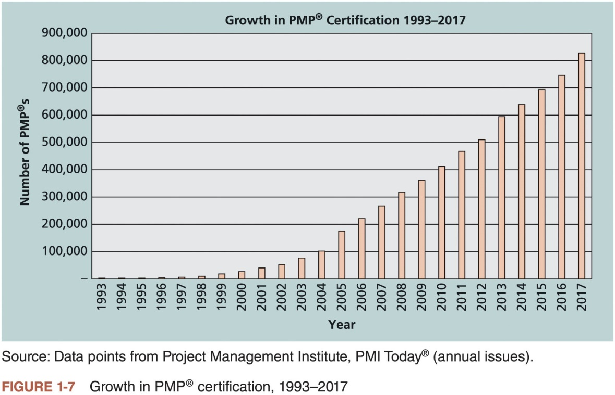
Project Management Certification (2 of 2)

Slide 52
Ethics in Project Management
Ethics, loosely defined, is a set of principles that guide our decision making based on personal values of what is “right” and “wrong”
Project managers often face ethical dilemmas
In order to earn PMP® certification, applicants must agree to PMI’s Code of Ethics and Professional Conduct
Several questions on the PMP® exam are related to professional responsibility, including ethics

Slide 53
Project Management Software*
There are hundreds of different products to assist in performing project management
Three main categories of tools:
Low-end tools: Handle single or smaller projects well, cost under $200 per user
Midrange tools: Handle multiple projects and users, cost $200-$1,000 per user, Microsoft Project is still the most popular
High-end tools: Also called enterprise project management software, often licensed on a per-user basis
Several free or open-source tools are also available

Slide 54
Chapter Summary
A project is a temporary endeavor undertaken to create a unique product, service, or result
Project management is the application of knowledge, skills, tools, and techniques to project activities to meet project requirements
A program is a group of related projects managed in a coordinated way
Project portfolio management involves organizing and managing projects and programs as a portfolio of investments
Project managers play a key role in helping projects and organizations succeed
The project management profession continues to grow and mature

